Slide 1


雅思口语
微博：杨帅-贵学
公众微信：Ielts-shuaige

Slide 2
Try to sound humorous
Try to be special
Try to make the examiner remember you
满分答案学习

Slide 3
Do you like to watch the sky?
Do I like to watch the sky? Um, it’s a really interesting question. I suppose I do, but this is because I have a stiff neck and looking up can help me feel more comfortable. Of course, sometimes, if it’s not smoggy, I will look up at some stars at night. But usually, there are just a few of them.

Slide 4
Do you like trees?
Um, do I like trees? That’s a weird question. You know, I like watching movies, I like playing soccer, but trees ... They’re extremely important, but I don’t have any special feelings for them.

Slide 5
Are there any colors that have special meanings in China?
Um, you know what, the first color that comes to mind is green. Generally it’s a pretty good color. It symbolizes life and nature. But you know, in China, a green hat has a very interesting connotation. If you say that someone wears a green hat, it means that their husband or wife, boyfriend or girlfriend is cheating on them.

Slide 6
Describe a special toy you had in your childhood
You should say
  What it was
  Who gave it to you
  How often you played with it
And explain why it was special to you

Slide 7
I had a GI Joe before, or maybe I should say it’s a GI Joe prototype. I think GI Joes are probably the most popular action figures in the world. Honestly, I’m proud that I had it as a child because as far as I know, it was not mass produced, so not many people had it. Well, um this GI Joe had brown hair and wore a green jacket. He looked pretty firm.
Um, it was not mass produced, so how did I get it? Well, when I was 7, my uncle came back from the United States with it and he gave it to me as a gift. I remember vividly he told me it was pretty rare cause it was not a regular GI Joe. Even to this day, I still have no idea how he got it.

Slide 8
How often I played with it ...well, you know, I was with it all the time. I took it to school, I took it on trips and I even went to bed with it cause you know, my uncle told me to treasure it.
Um, anyway, this GI Joe was really special to me primarily because it was not easy to get hold of. Actually, one of my American friends told me that such a GI Joe prototype was sold for 200 thousand dollars on Ebay a while back. Now I feel sad because I lost it on a trip when I was about 9. If I still had it, I guess a lot of people would pay an arm and a leg in order to own it.

Slide 9
the most popular action figures in the world
mass produced
gave it to me as a gift
I remember vividly
a regular GI Joe
treasure
not easy to get hold of
was sold for 200 thousand dollars on Ebay a while back
pay an arm and a leg in order to own it.

Slide 10
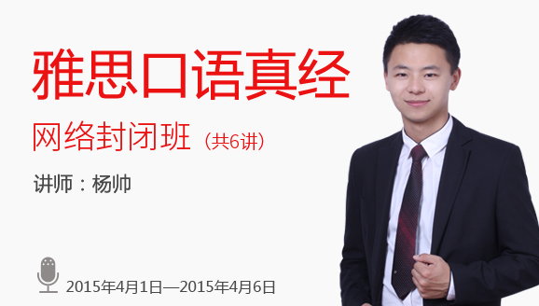

Slide 11
150句：提高语法、词汇、发音
逻辑扩展法：下句不再靠缘分，提高流利度、连贯性
所有题目素材
提高分数的最快方法是提高能力
走错路，你会越走越远

Slide 12
雅思口语
微博：杨帅-贵学
公众微信：Ielts-shuaige

Slide 13
